Slide 1
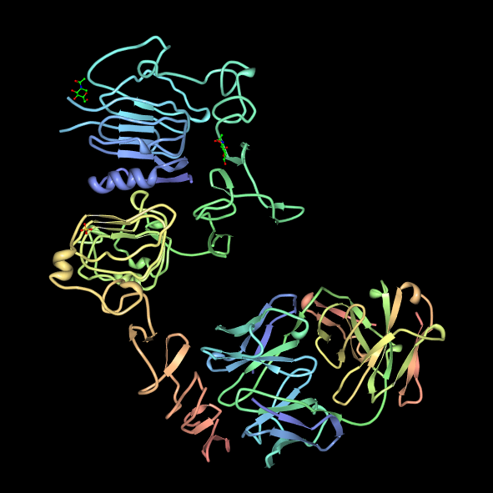
Intro to Biotech
Lect.8
DNA – mRNA – protein
Activity
Mutations:
• germline vs somatic
• point vs chromosomal
• silent
• missense
• nonsense
• frameshift
• deletion
• duplication
• how arise?
Why do we care?

Slide 2
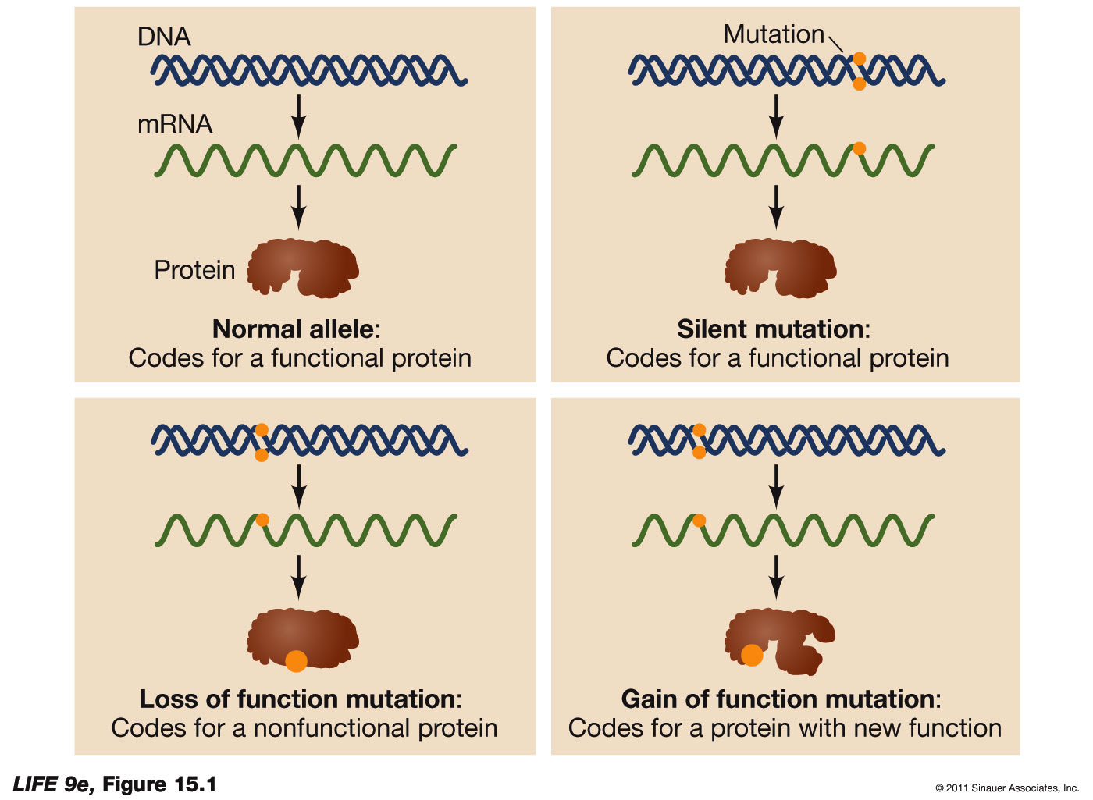
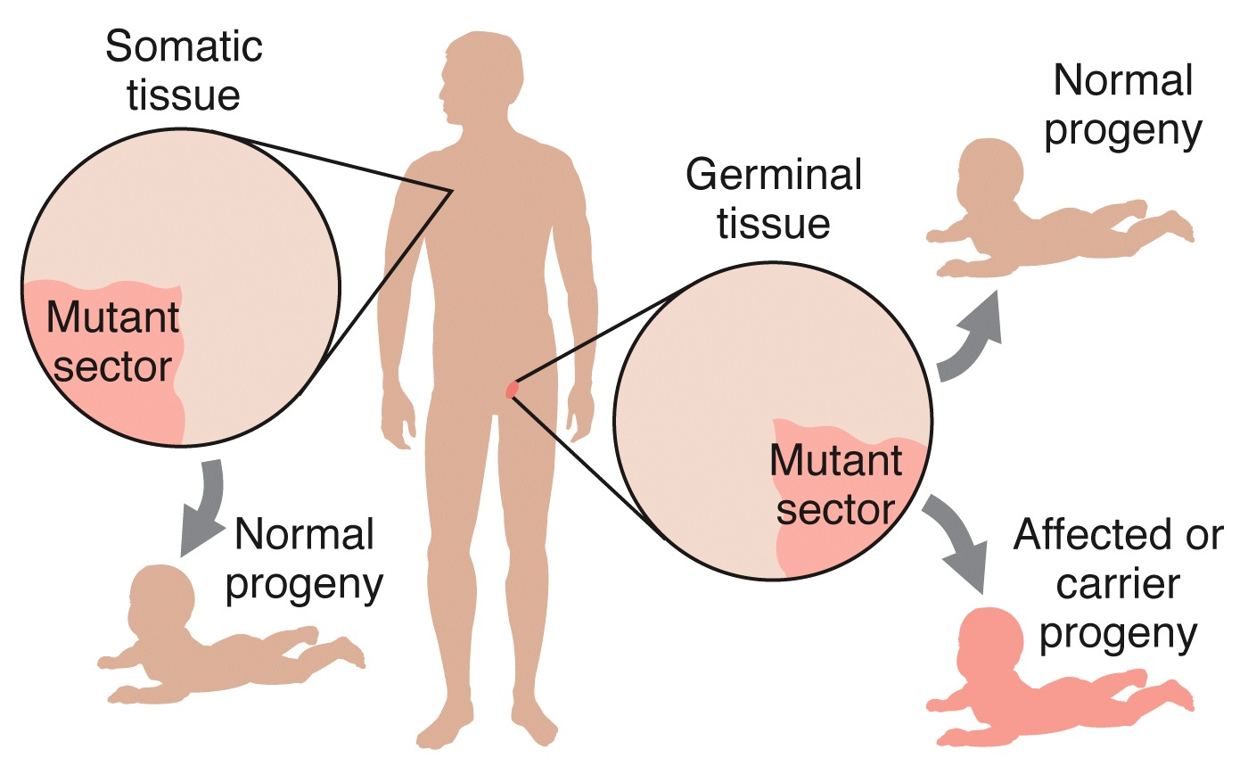
Intro to Biotech
Lect.8
Gene Mutations and Molecular Medicine
• What Are Mutations?
-
Genetic mutations:
Transmittal: (tissue affected)
-
- Mutations may or may not have a phenotypic effect.

Slide 3
Intro to Biotech
Lect.8
Gene Mutations and Molecular Medicine
• What Are Mutations?
Mutational Effect
hypomorph
hypermorph
amorph
neomorph
antimorph

Slide 4
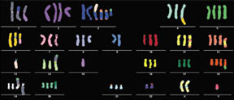
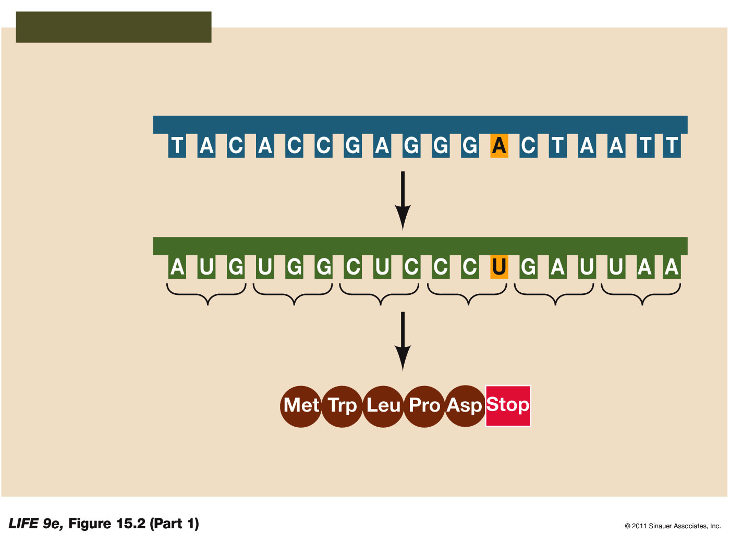
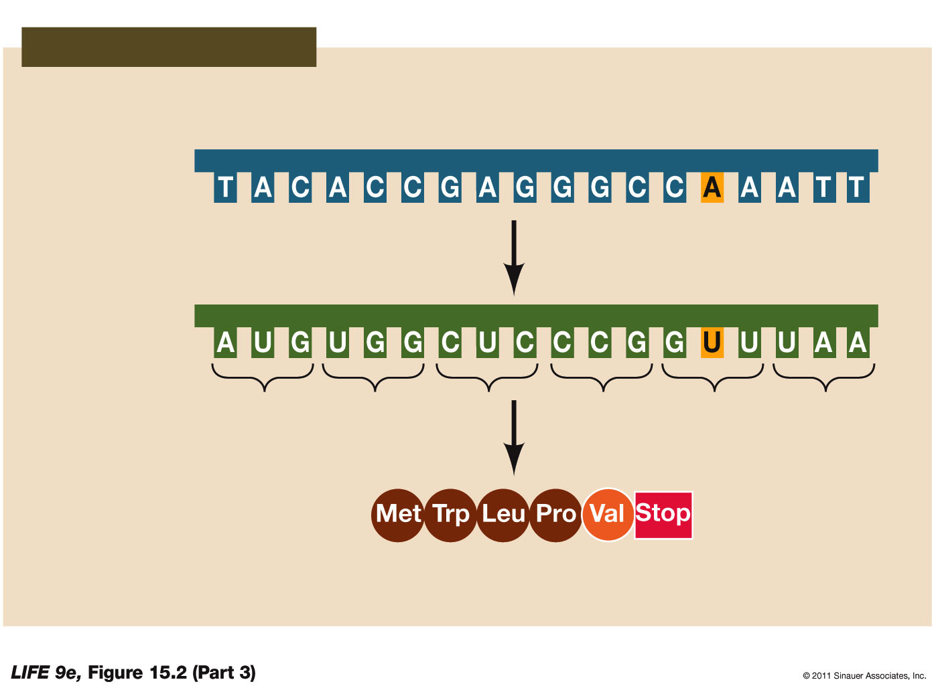
Intro to Biotech
Lect.8
Gene Mutations and Molecular Medicine
Types of Mutation
Point
Chromosomal
Silent
Missense
Conservative
Nonconservative

Slide 5
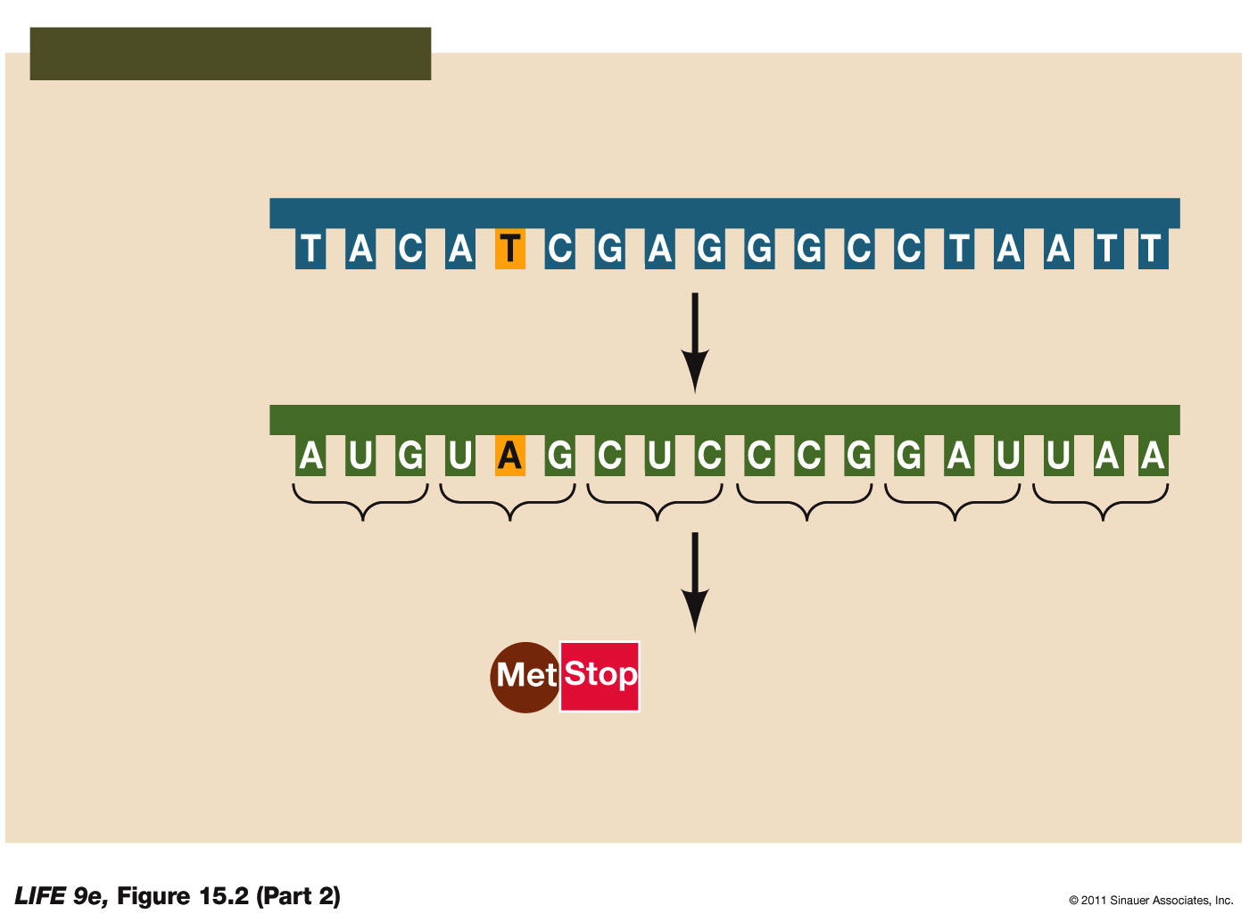
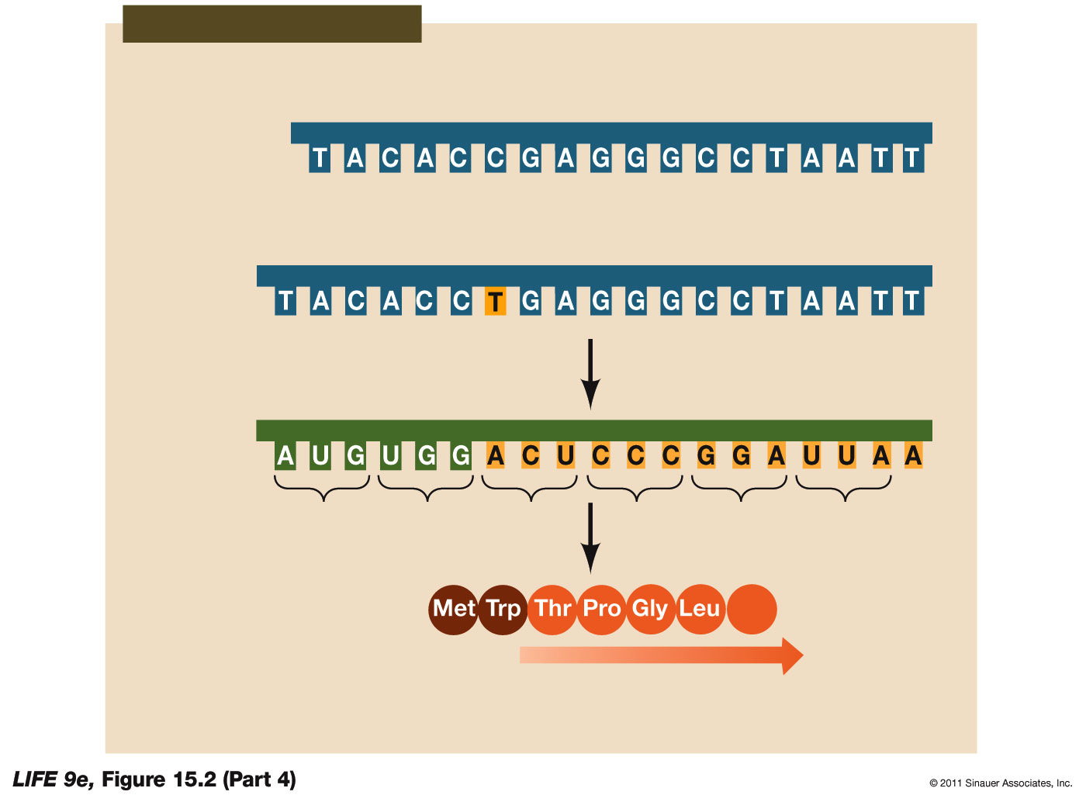
Intro to Biotech
Lect.8
Gene Mutations and Molecular Medicine
Types of Mutation: POINT
Nonsense
Frameshift

Slide 6
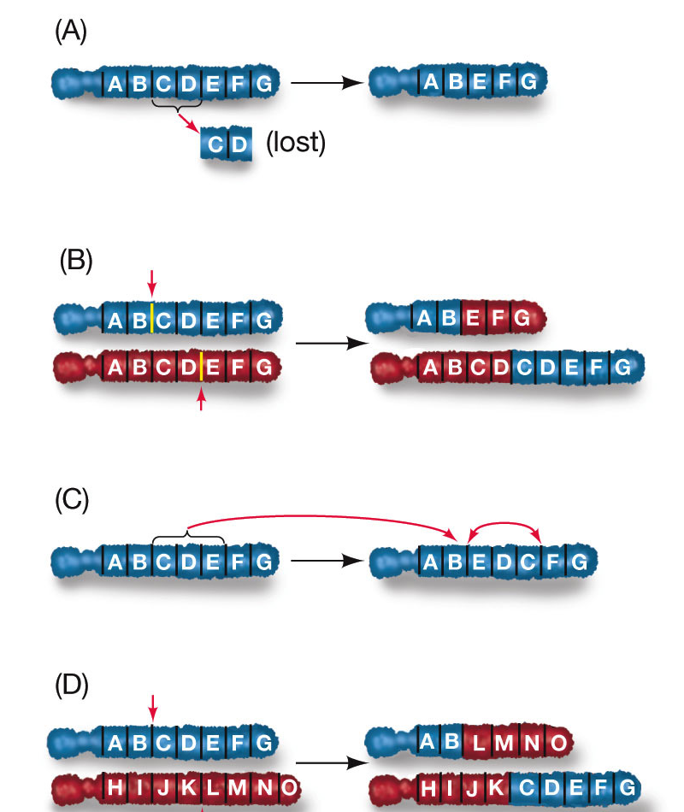
Intro to Biotech
Lect.8
Gene Mutations and Molecular Medicine
Types of Mutation: CHROMOSOMAL

Slide 7
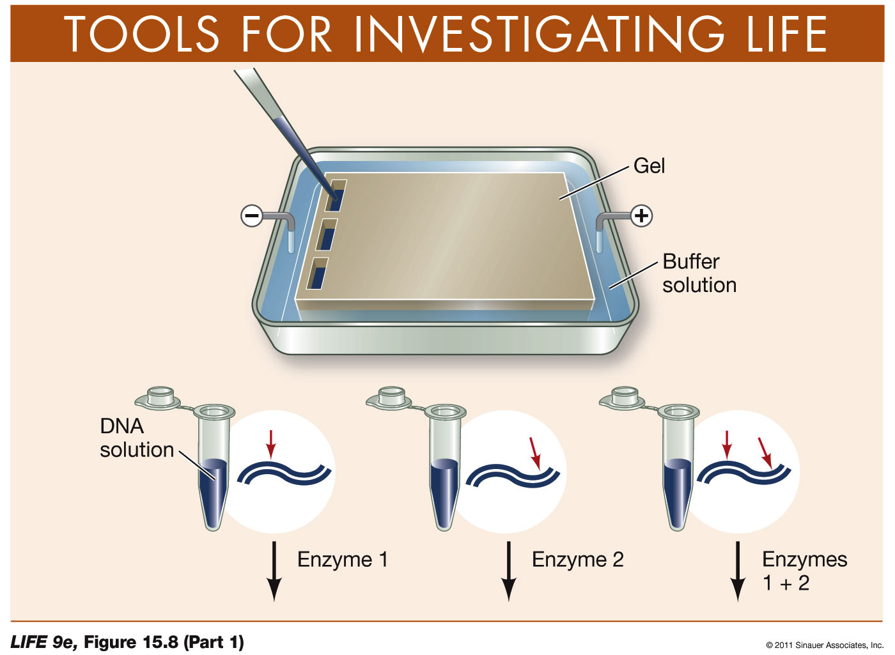
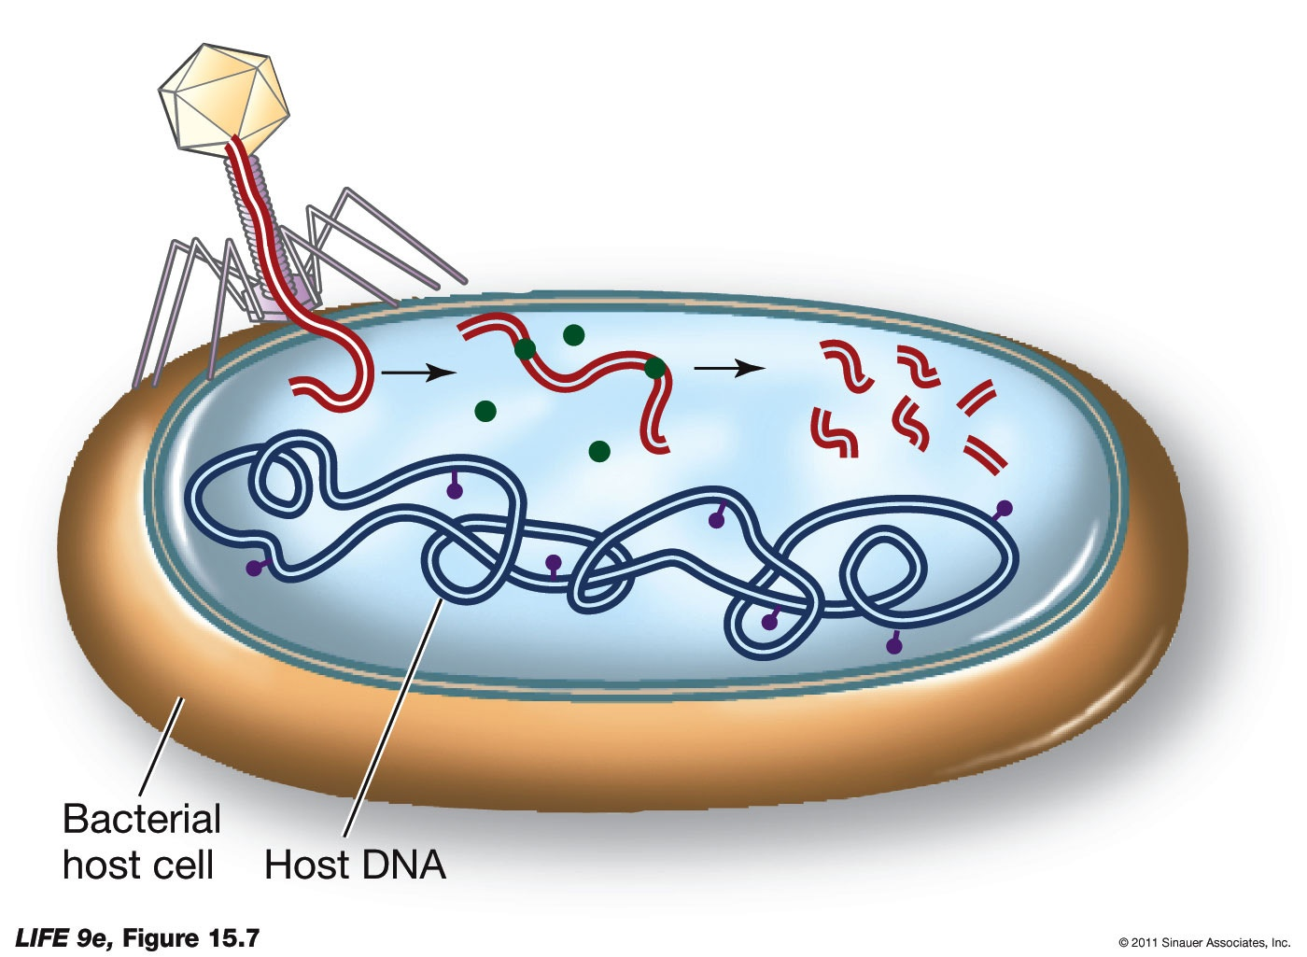
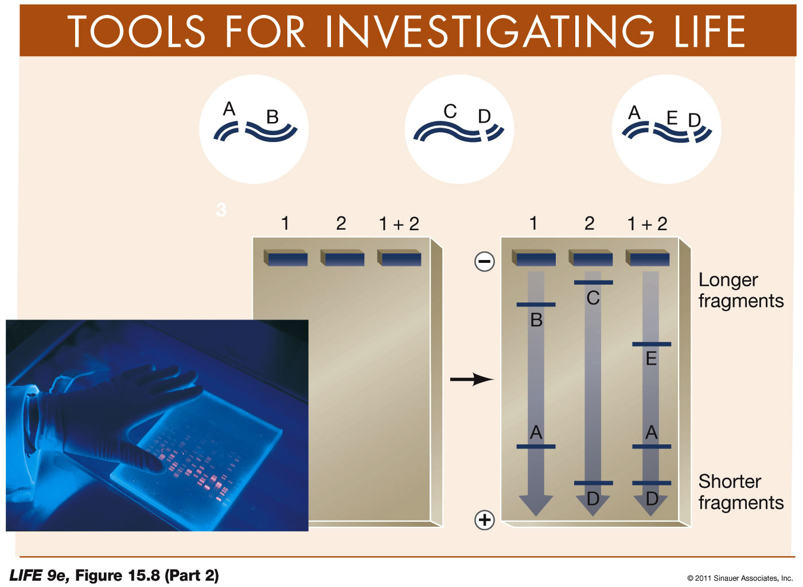
Intro to Biotech
Lect.8
How Are DNA Molecules and Mutations Analyzed?
Restriction enzymes
Gel electrophoresis

Slide 8
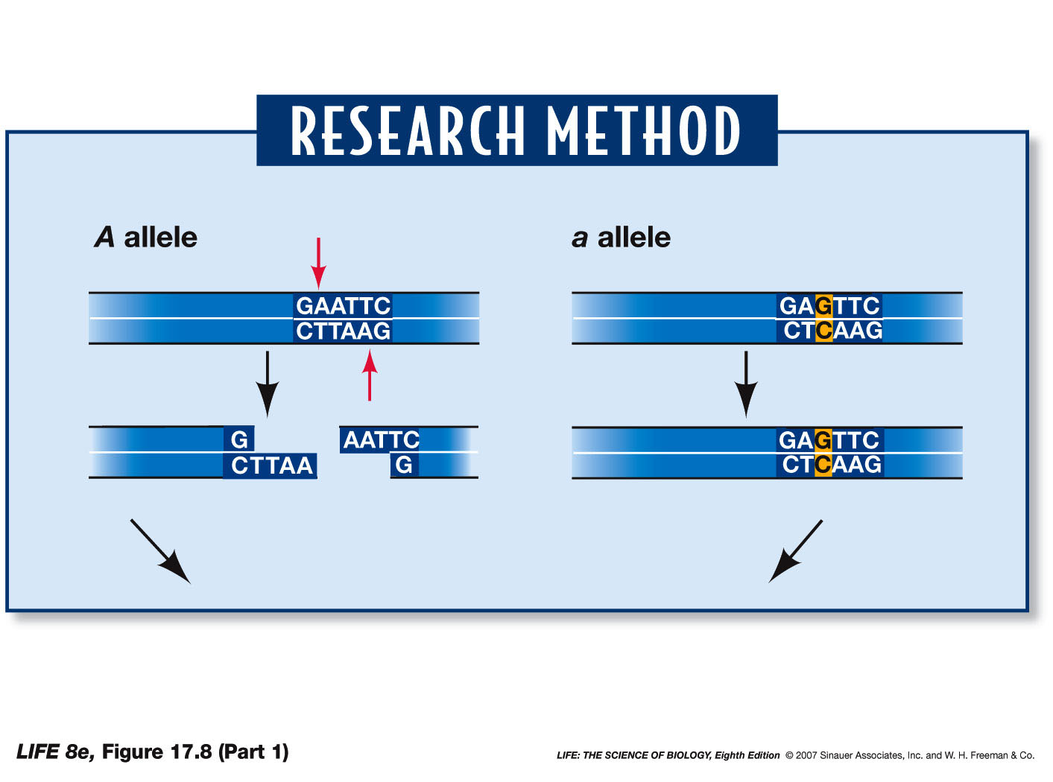
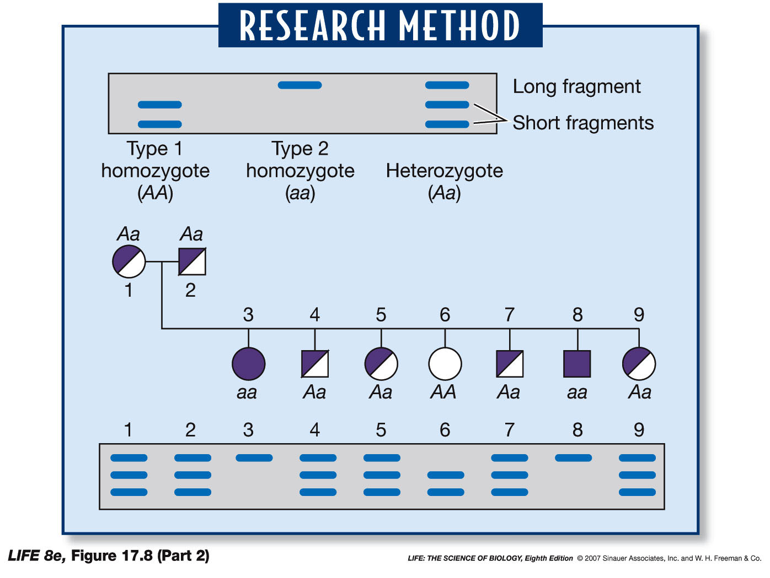
Intro to Biotech
Lect.8
What DNA Changes Lead to Genetic Diseases?
comparative genomics – genome prospecting
a.
Single nucleotide
Polymorphism:
• DNA variation
• > 1% of population
Restriction fragment length
Polymorphism:
• alters restriction site
• use for allelic genotyping
• linkage to disease
b.
c.

Slide 9
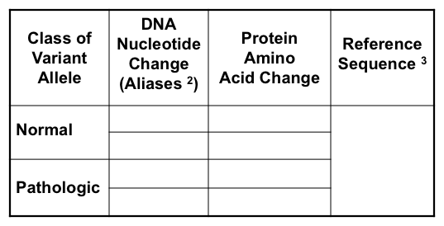
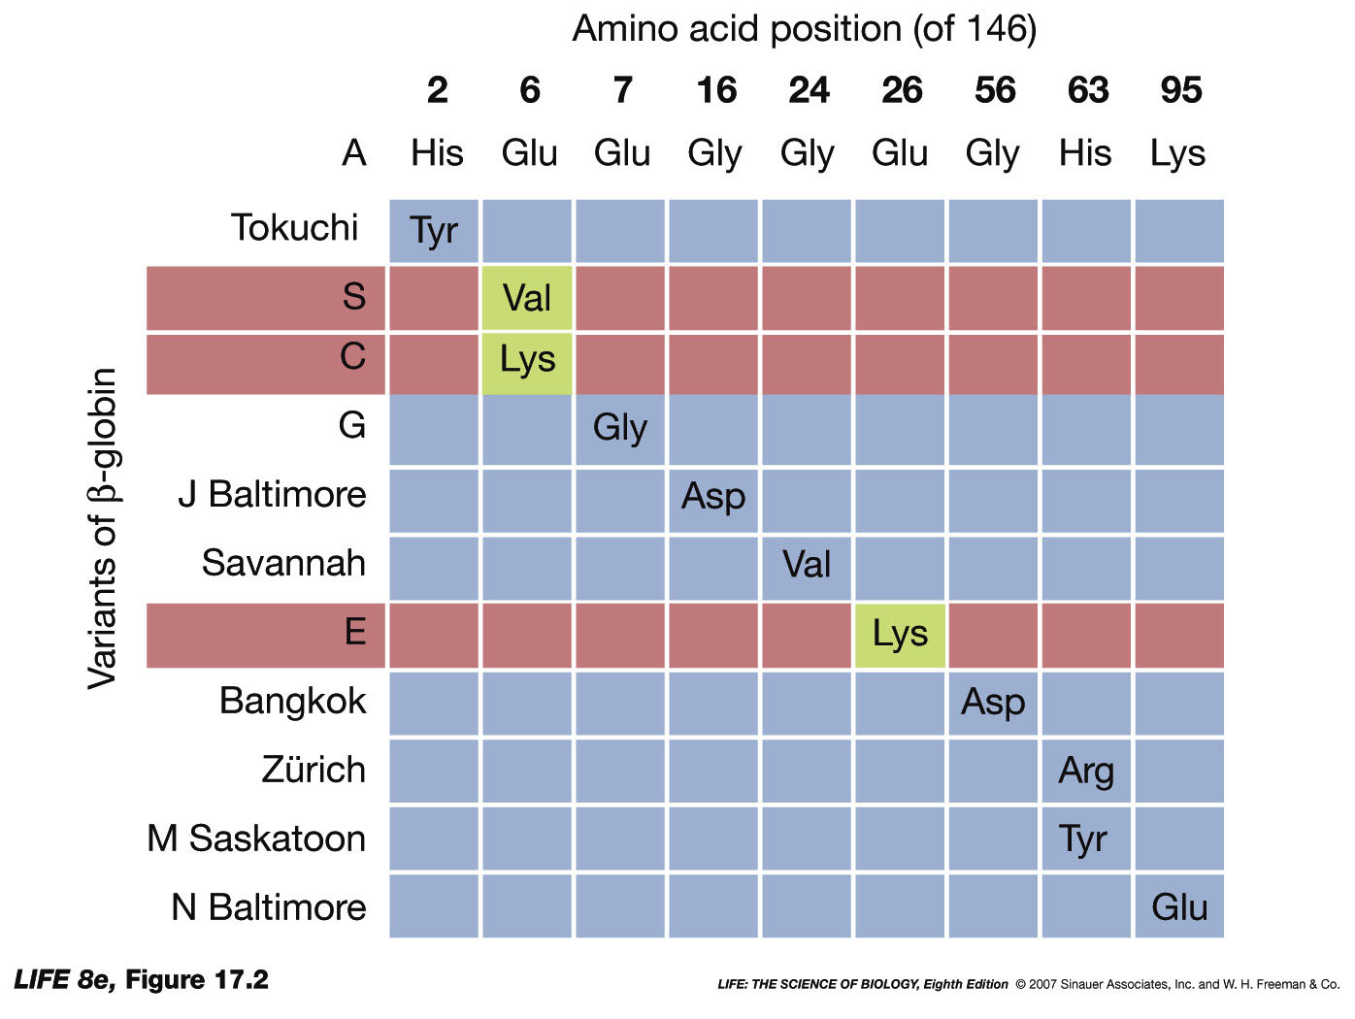
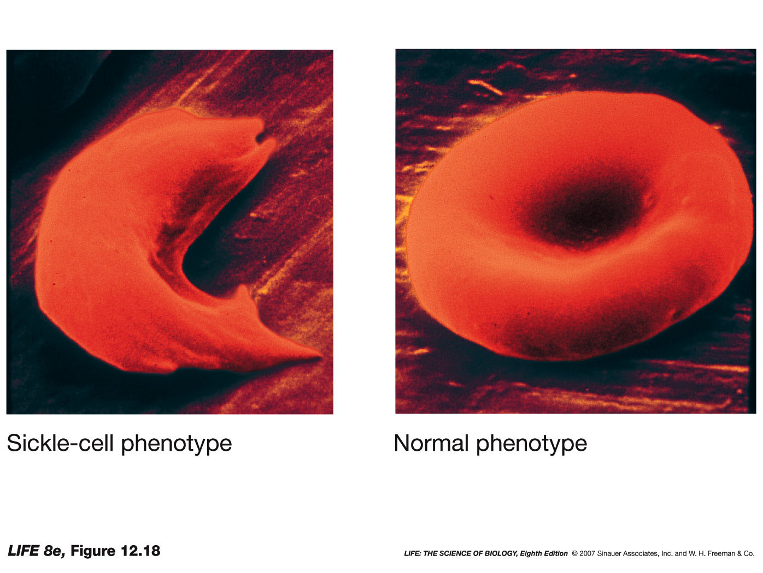
Intro to Biotech
Lect.8
What DNA Changes Lead to Genetic Diseases?
How do defective genes/proteins lead to diseases?
Single aa change in ß globin can =
- 1st genetic disease linked to aa change

Slide 10
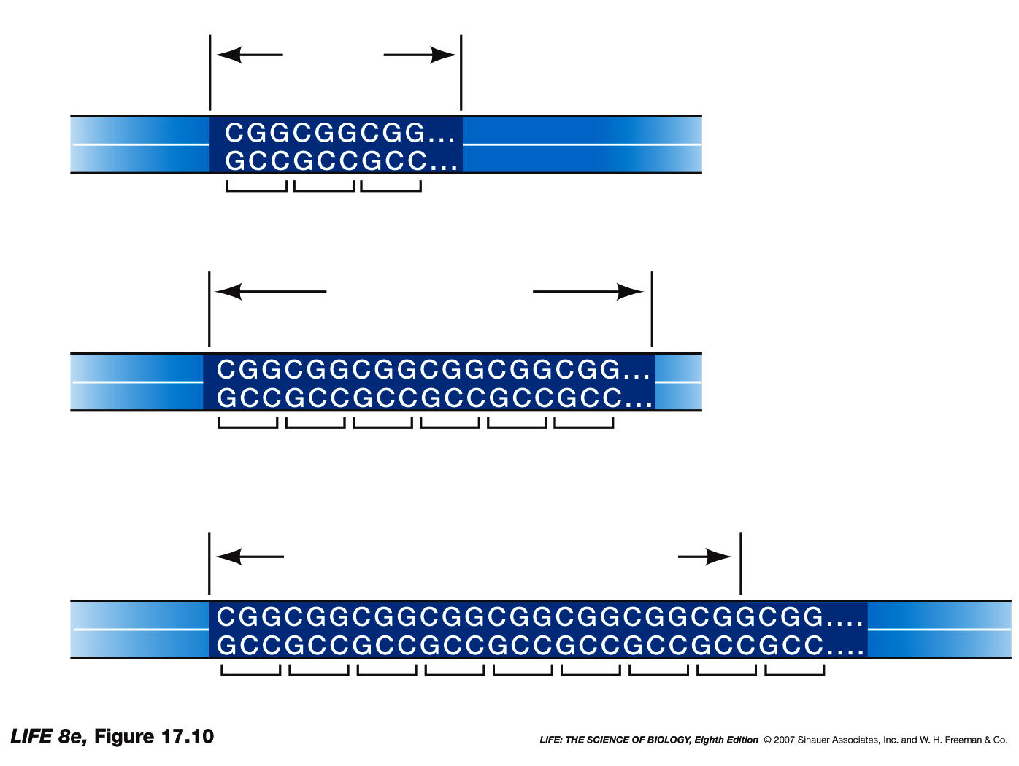
Intro to Biotech
Lect.8
How do defective genes/proteins lead to diseases?
b. Sequence expansions –
1. Fragile X =
6-54 = wt
55-200 = premutation
200-2000 = disease
FMR-1
binds mRNAs in neurons
2. X-linked muscular atrophy =
21 = wt
40-52 = disease
disrupt androgen receptor
3. myotonic dystrophy =
5 = wt
50 = mild disease
1000 = severe disease

Slide 11
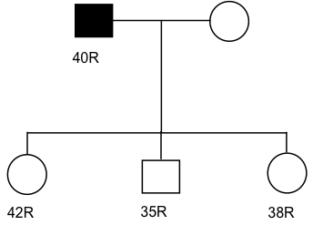
Intro to Biotech
Lect.8
How do defective genes/proteins lead to diseases?
b. Sequence expansions – trinucleotide repeats
wt
premutated
diseased
Case Study:
genetests.org
Three children - 50% risk to inherit Huntington disease from their father.
Genetic Testing:

Slide 12
Intro to Biotech
Lect.8
How do defective genes/proteins lead to diseases?
b. Sequence expansions – trinucleotide repeats
Case Study:
genetests.org
Do they have different risks for developing disease?
•
•
•

Slide 13
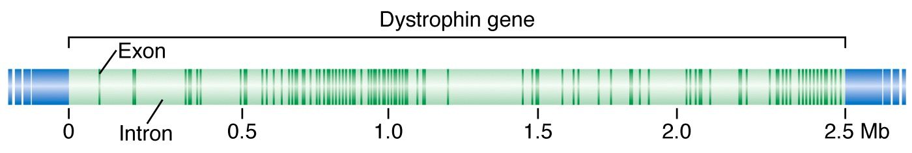
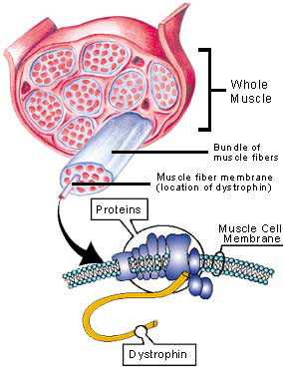
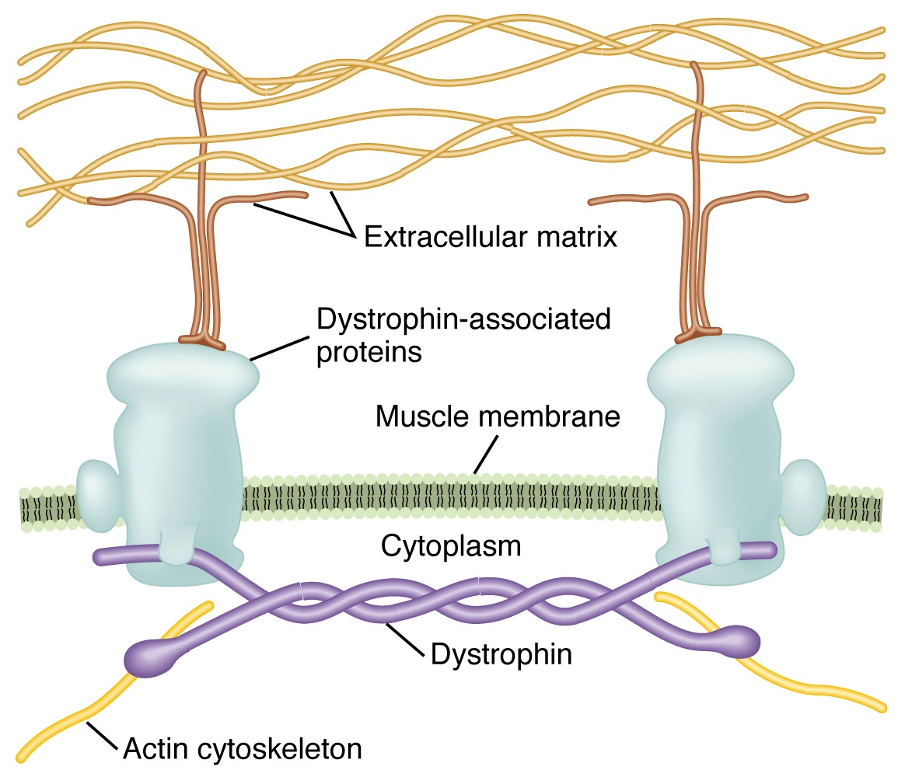
Intro to Biotech
Lect.8
How do defective genes/proteins lead to diseases?
c. Deletions:
Gene structure
• 2.6mb, 79 exons,
• 14kb mRNA
• ~1/3000 – Why?
• DMD =
- onset 2-6yrs old
- rare beyond 30yrs
• BMD =
- adolescence/adulthood
- mid late adulthood

Slide 14
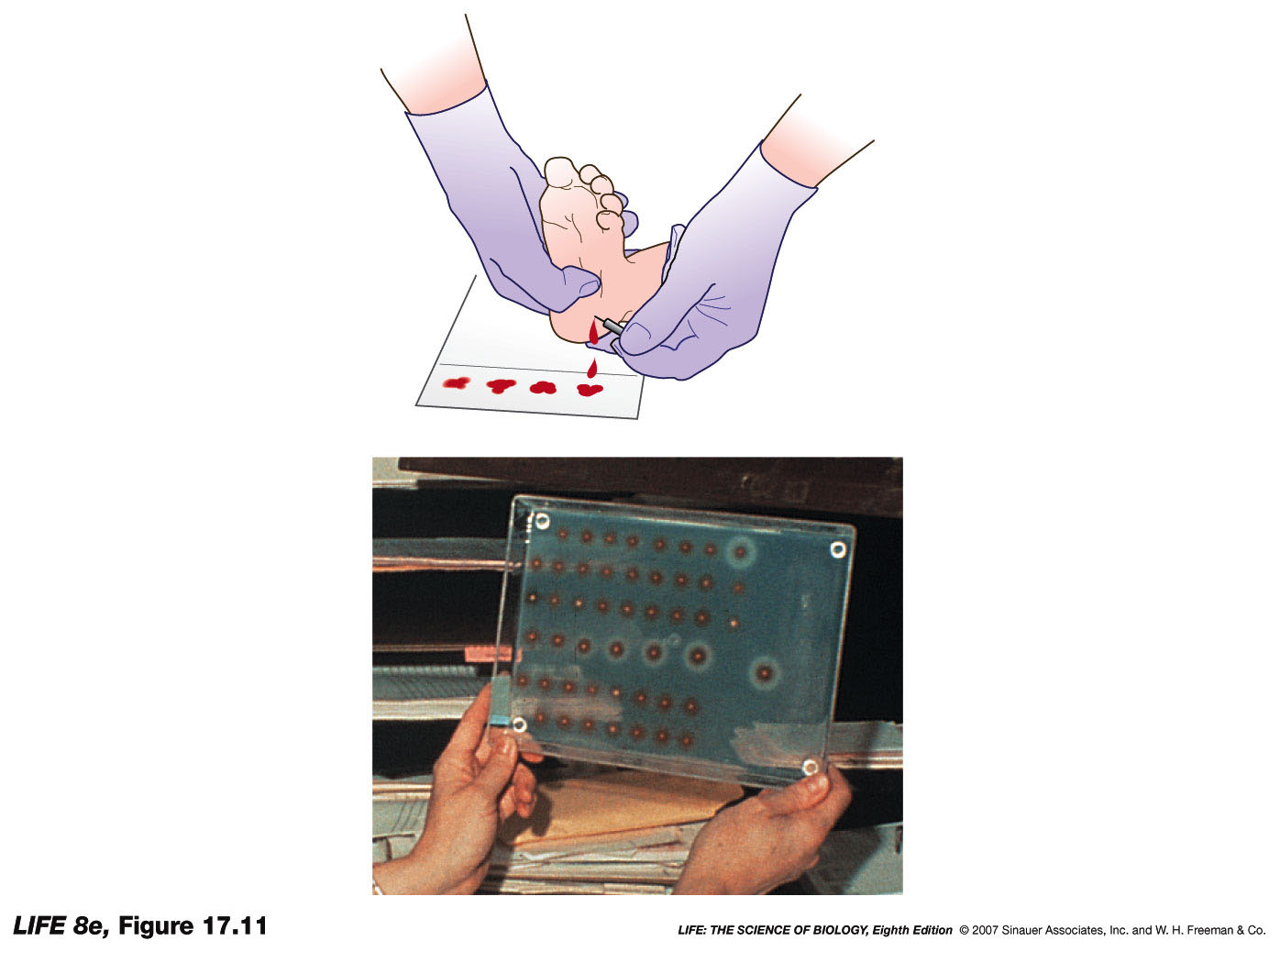
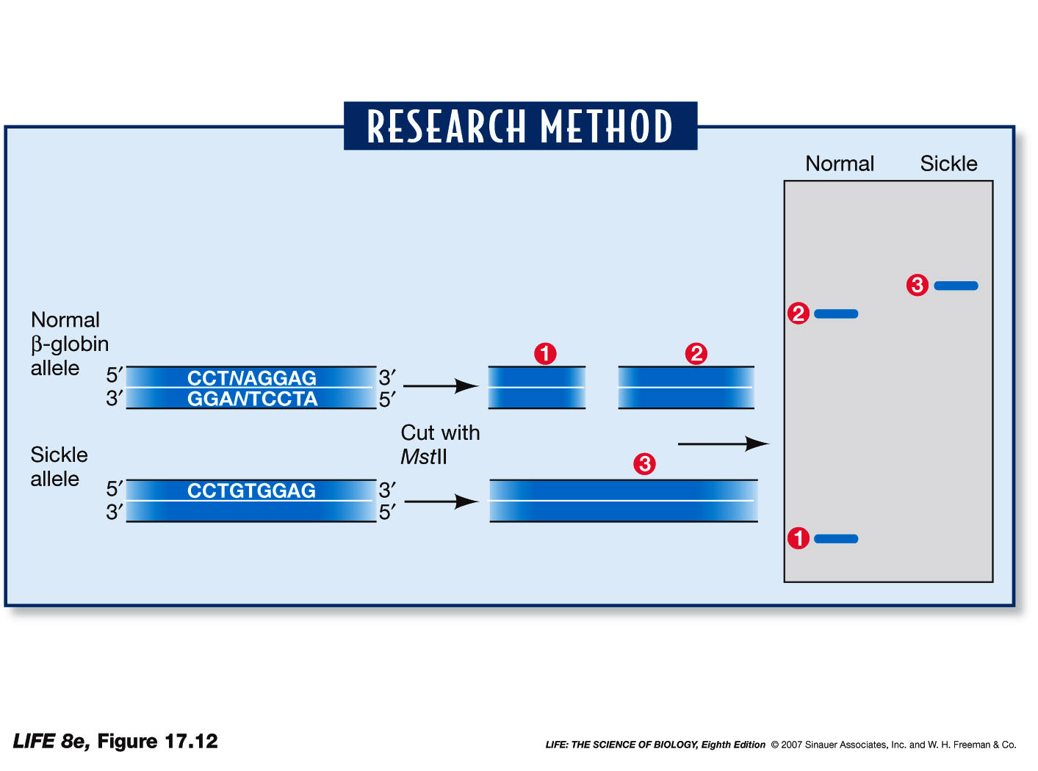
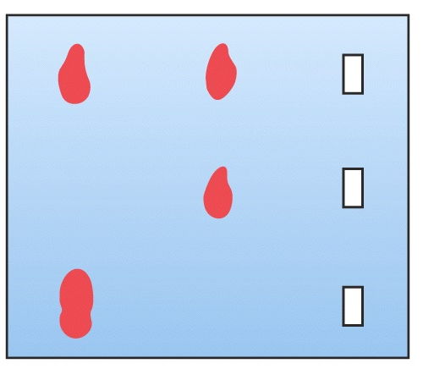
Intro to Biotech
Lect.8
How Is Genetic Screening Used to Detect Diseases? (>900)
a.
b.
How are Genetic Diseases Treated?
a. – PKU, limit phenylalanine
b. – statins – block cholesterol
c. – restore gene function (>900 trials)

Slide 15
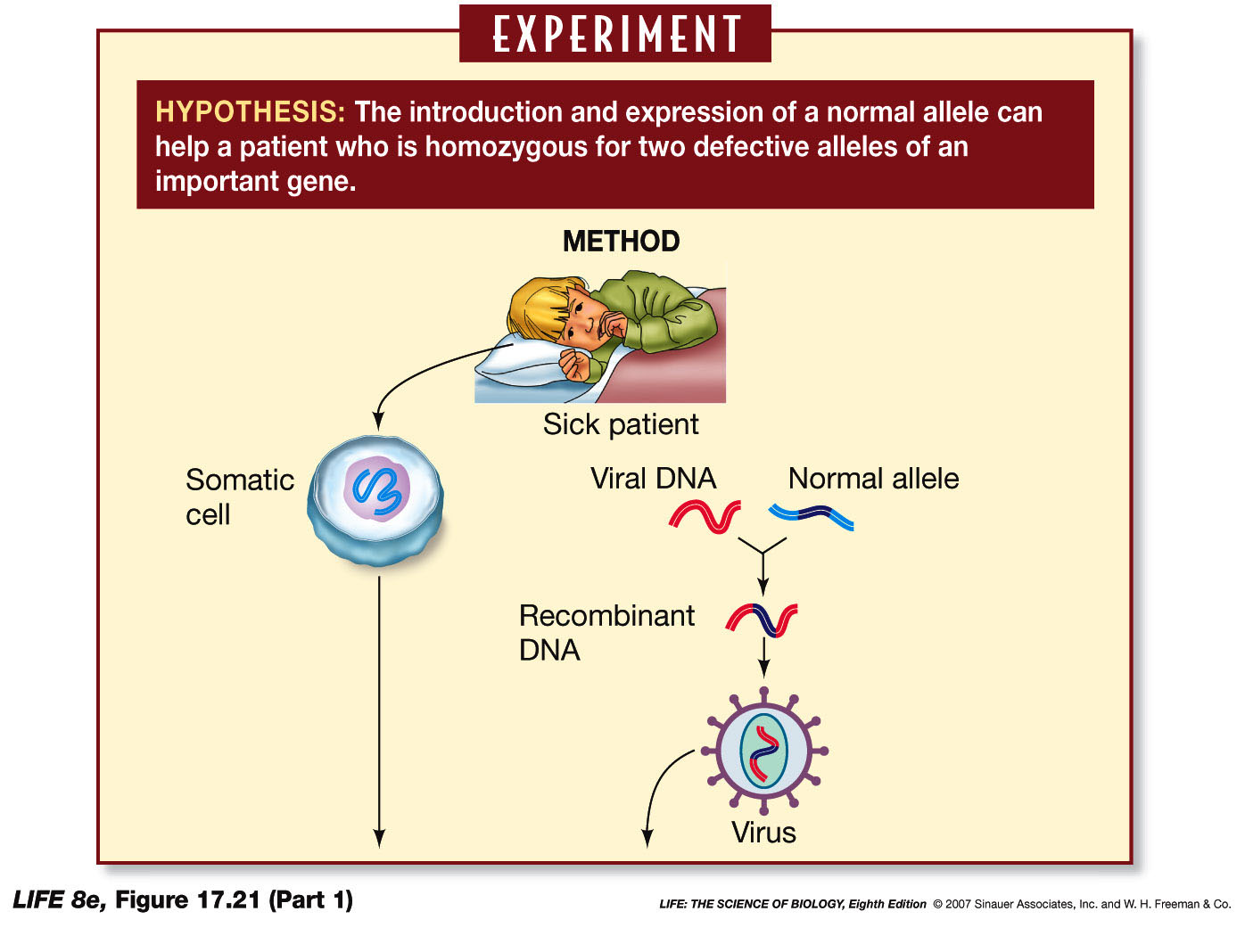
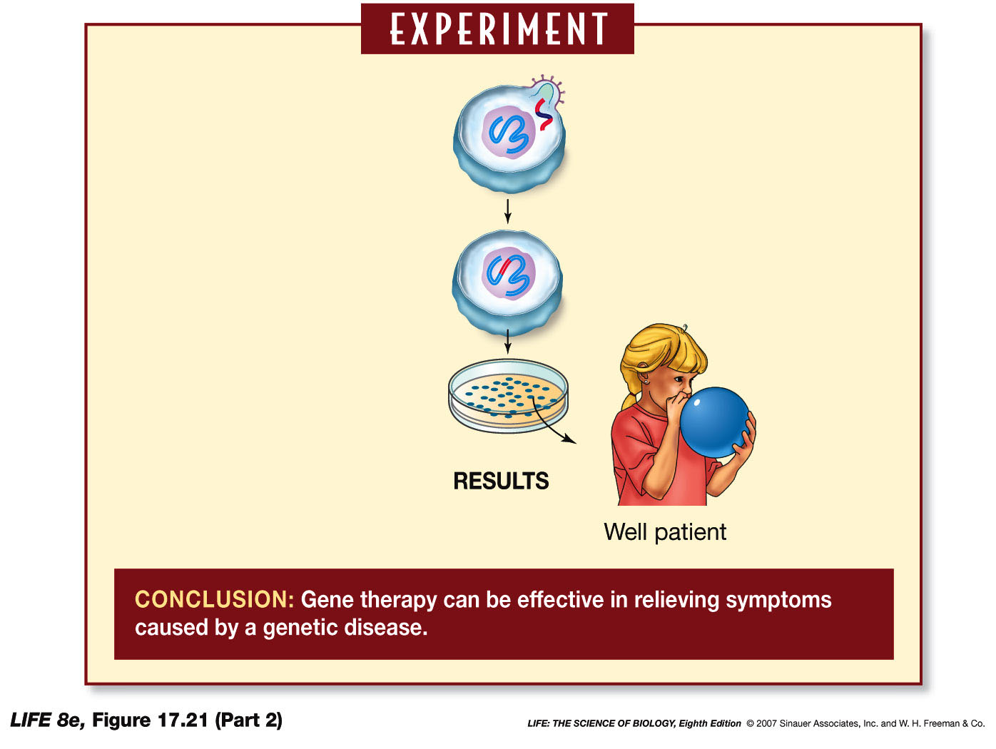
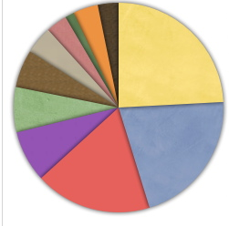
Intro to Biotech
Lect.8
How are Genetic Diseases Treated?
c. gene therapy – restore gene function (>900 trials)
Gene therapy vectors
Type of mutation - important?

